Slide 1
Sex-Specific GWAS
Phenotype 2

Slide 2
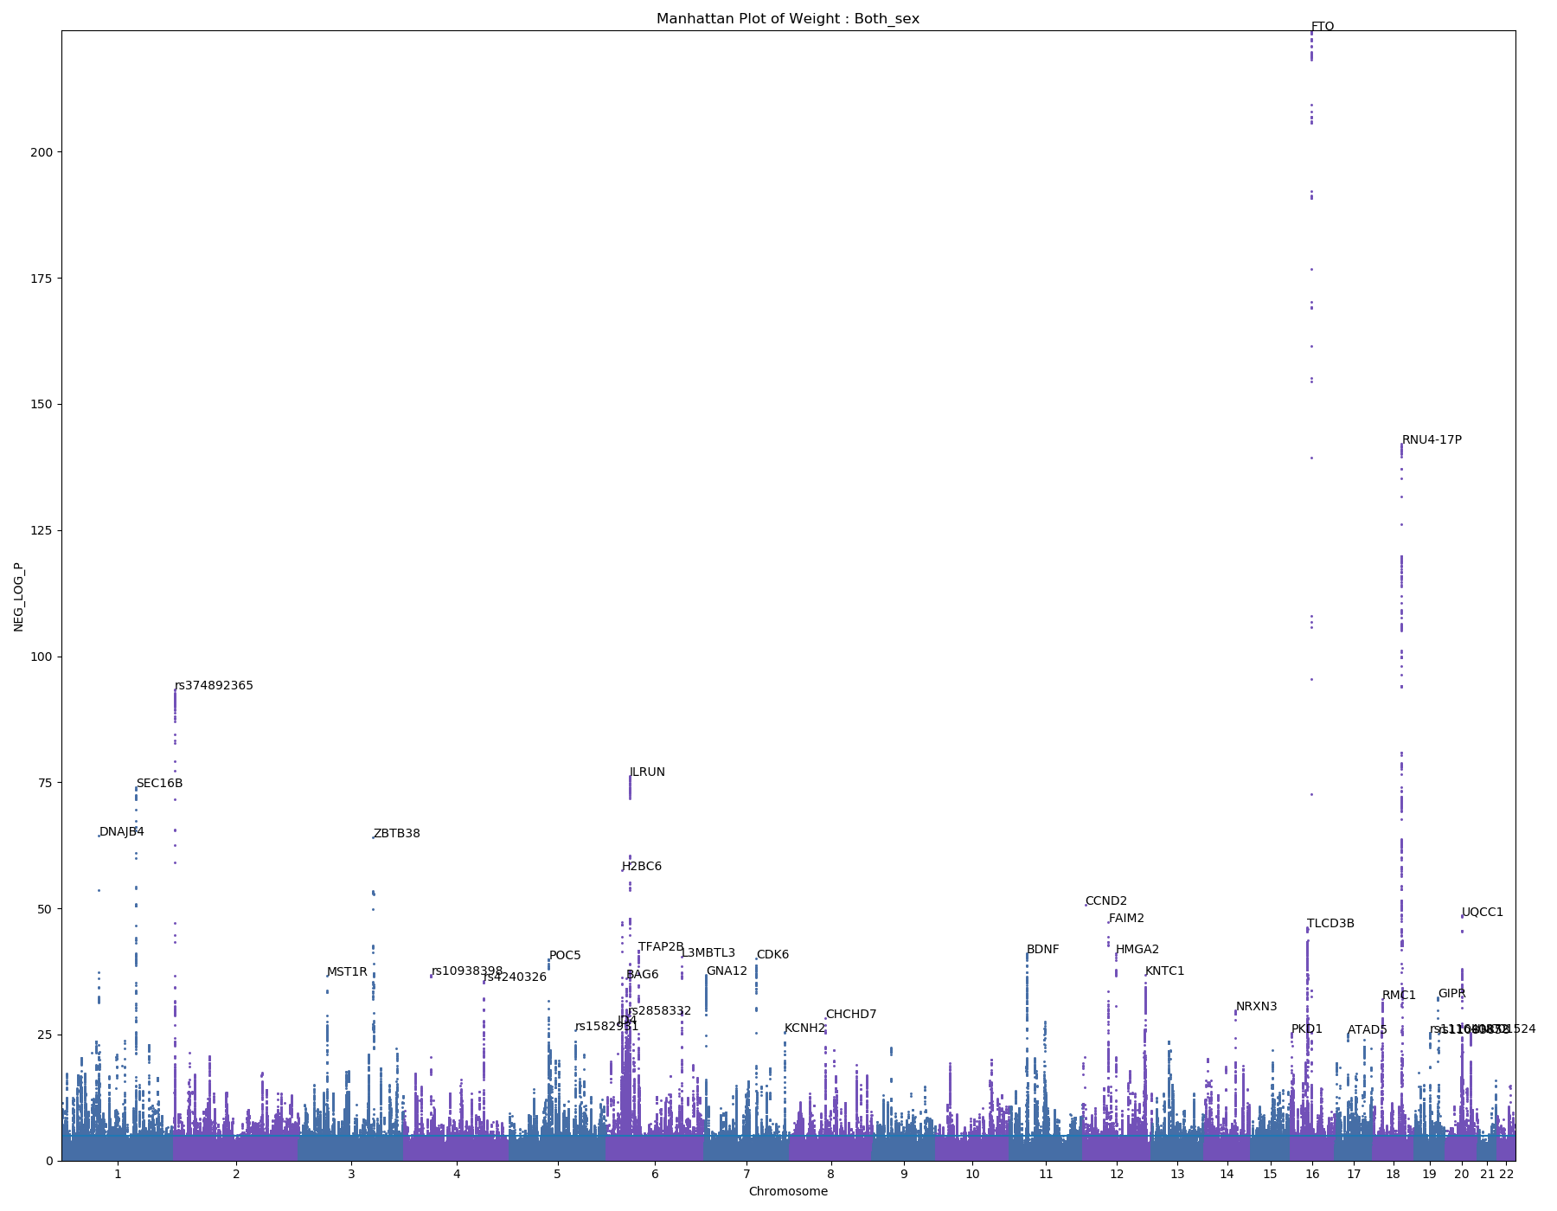
Weight

Slide 3
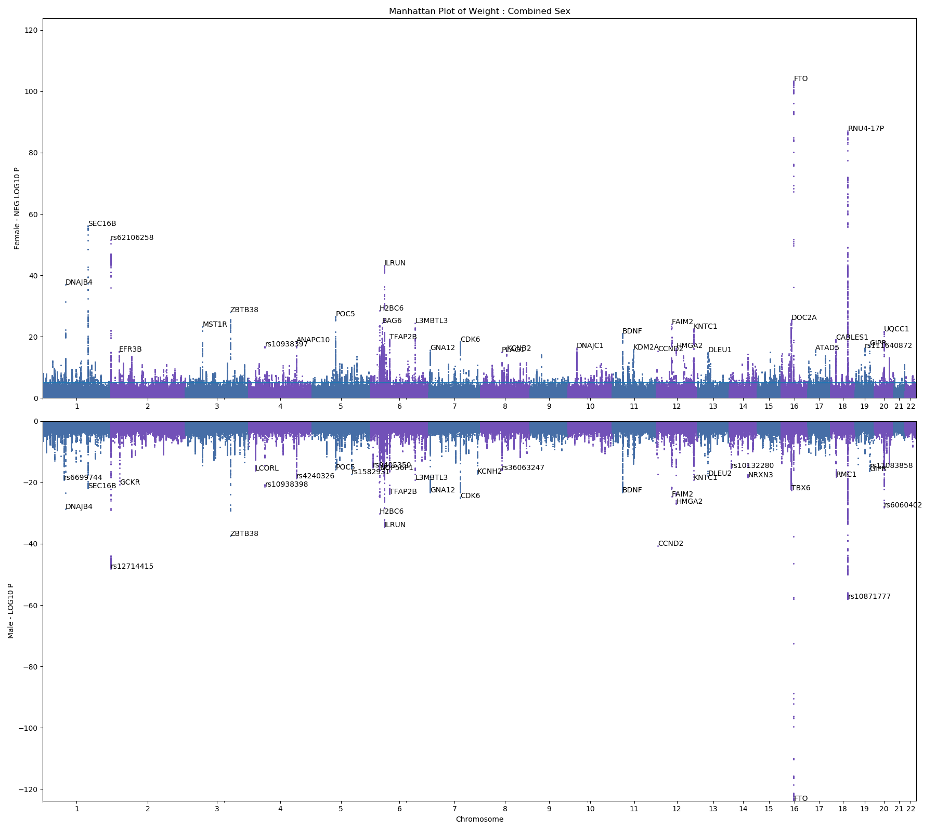
Weight – M/F

Slide 4
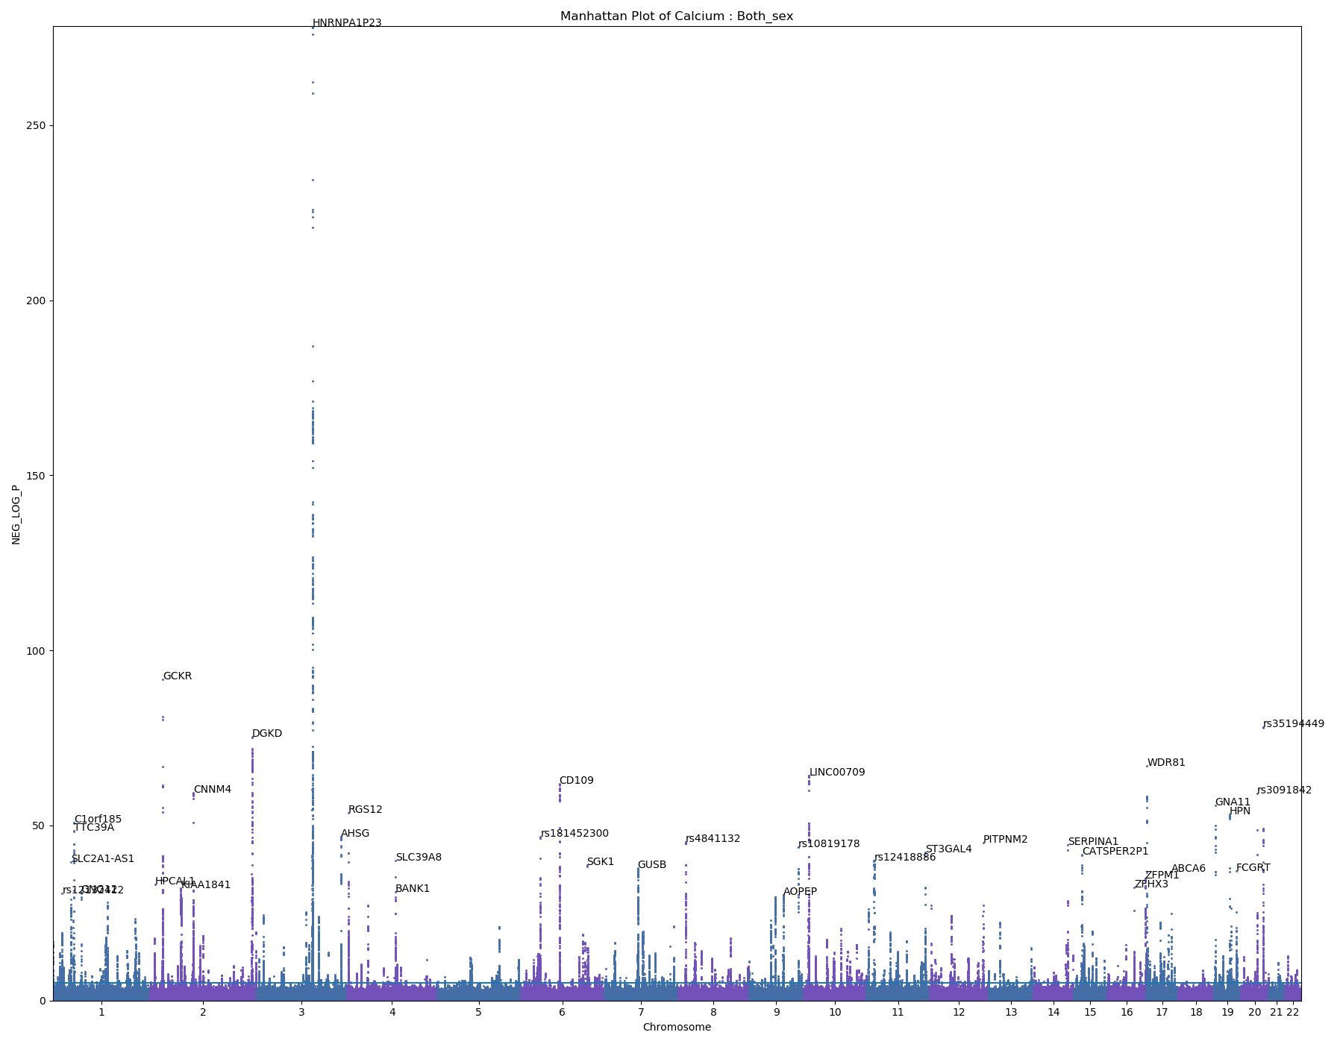
Calcium

Slide 5
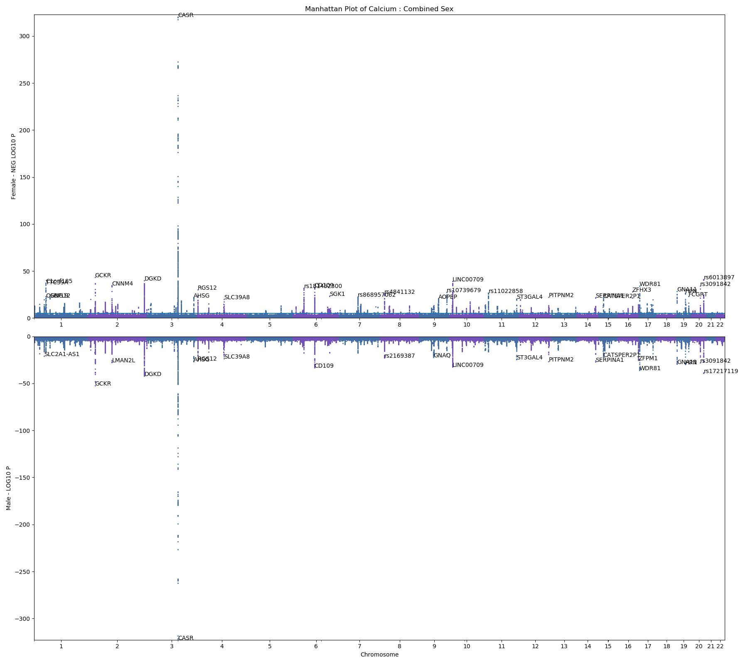
Calcium – M/F

Slide 6
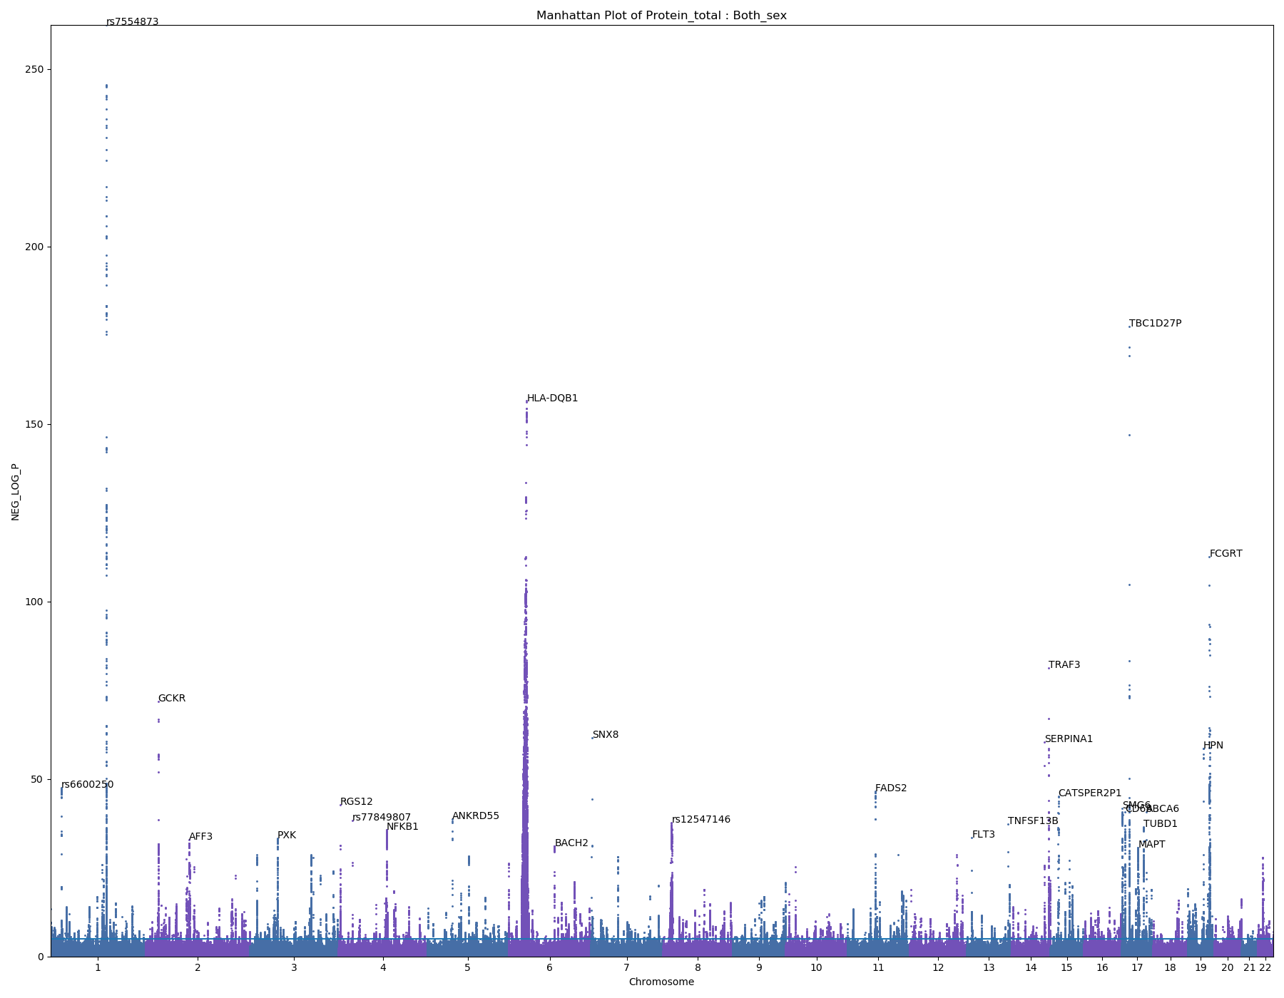
Total Protein

Slide 7
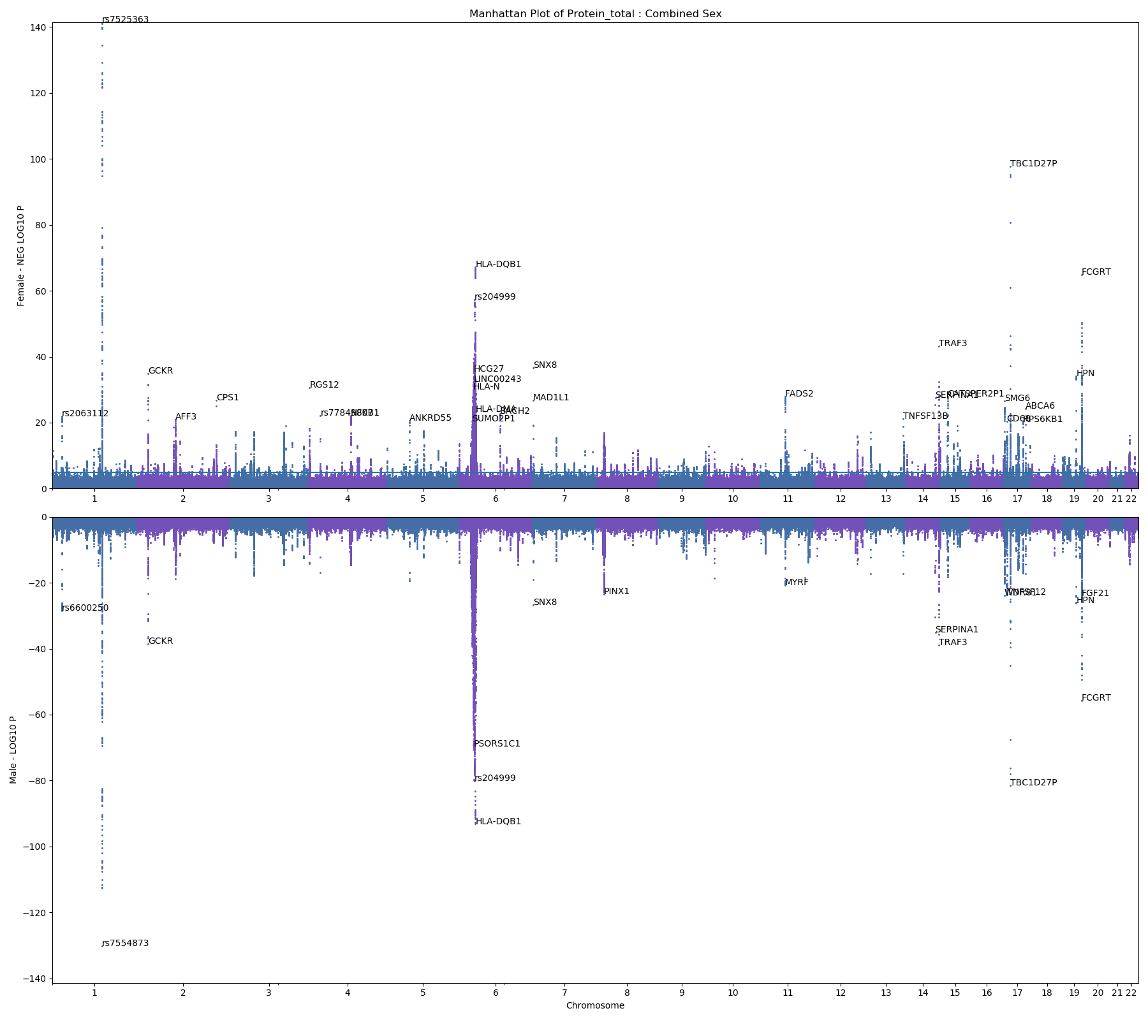
Total Protein – M/F

Slide 8
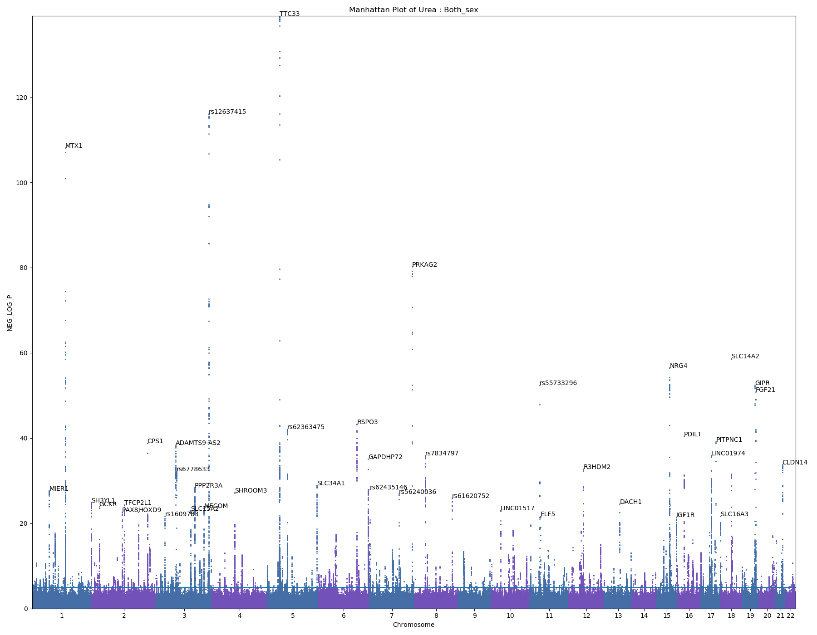
Urea
Breakdown product of protein
Excreted in urine

Slide 9
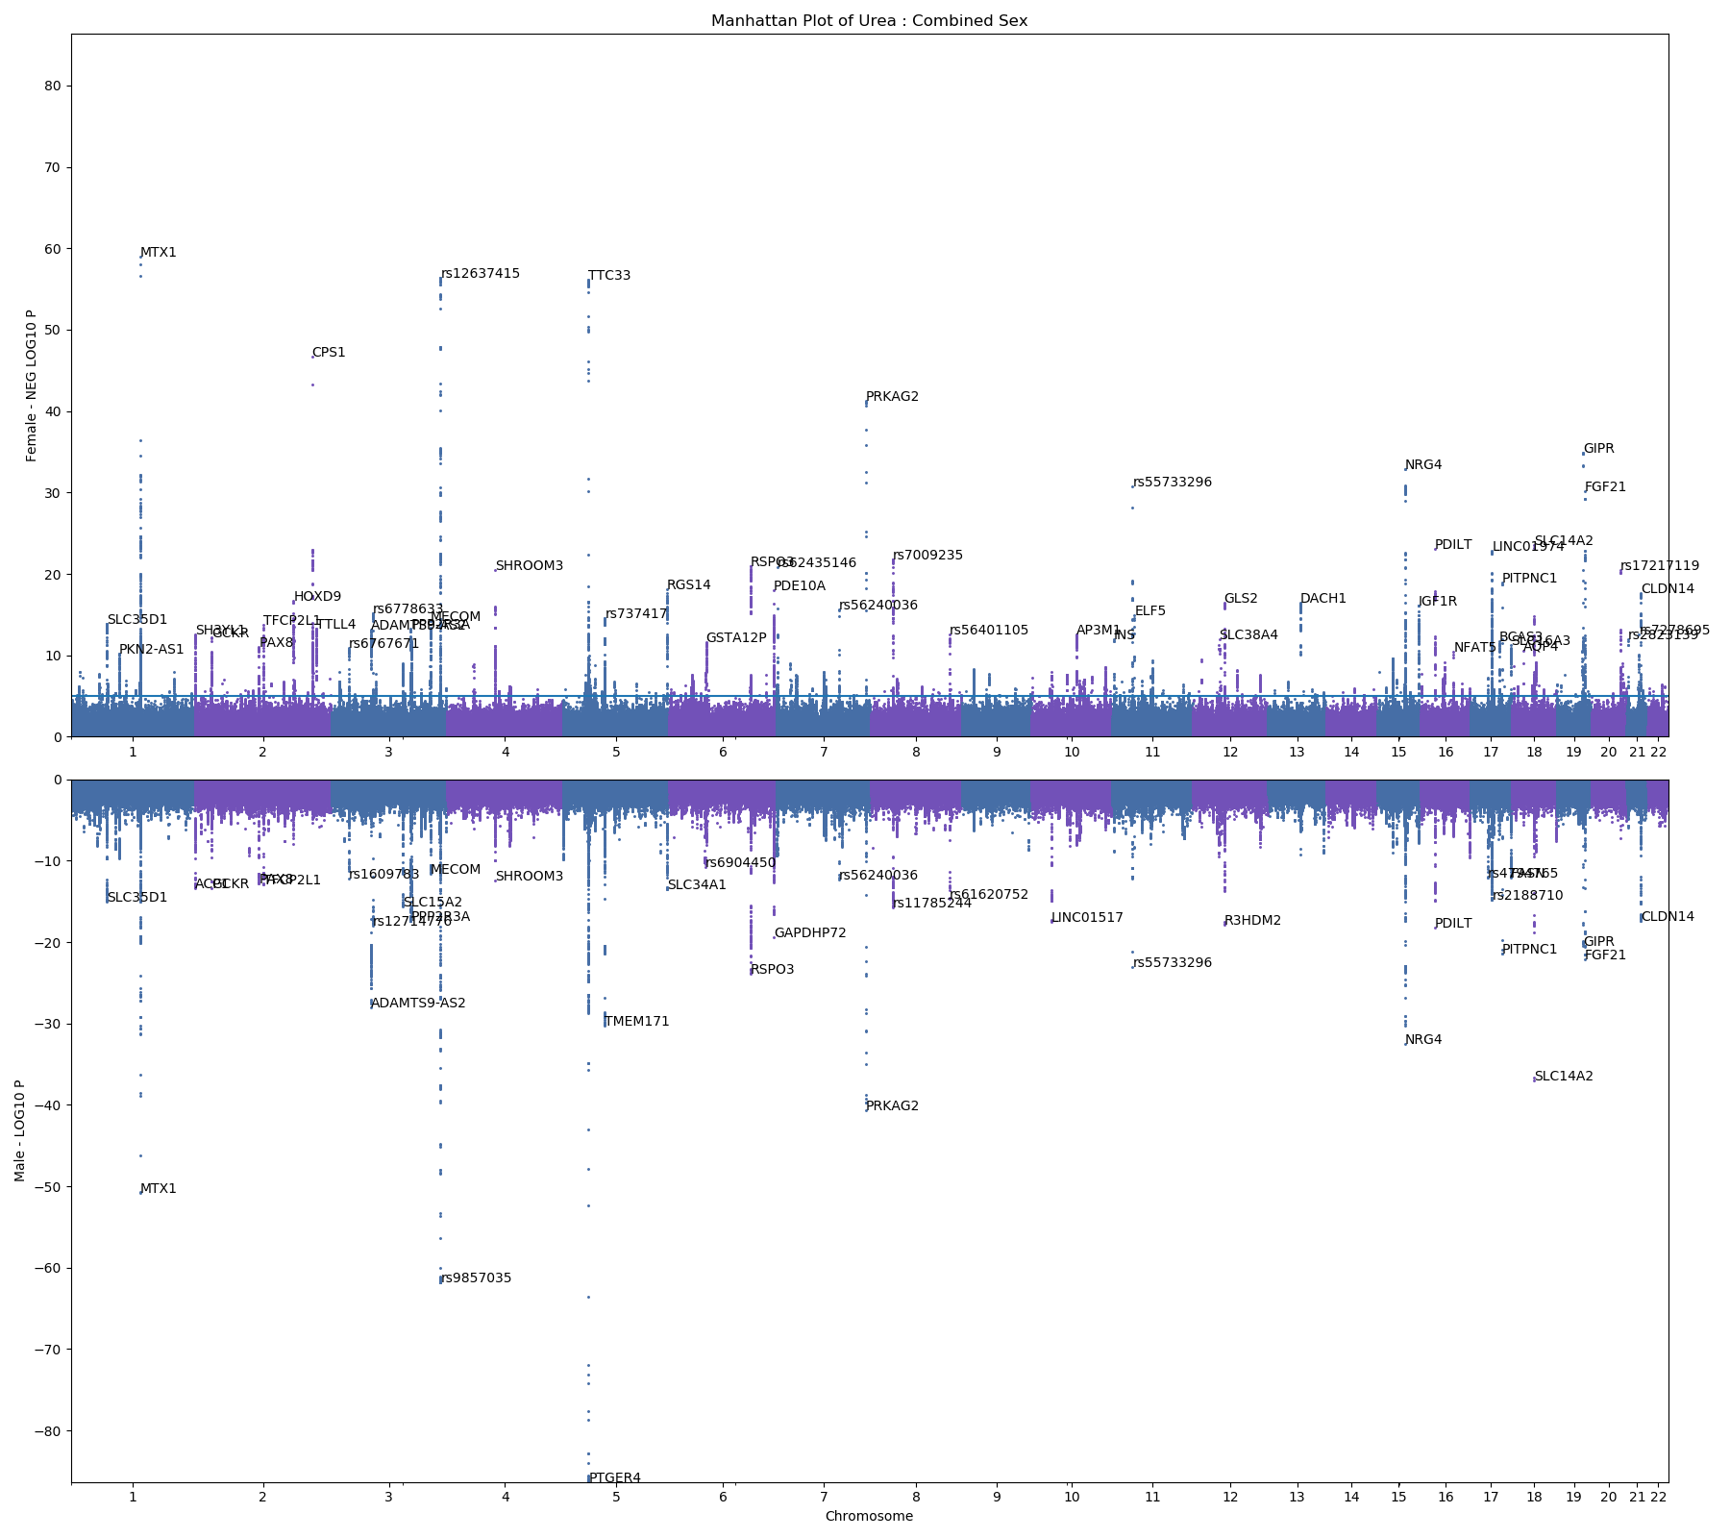

Urea – M/F

Slide 10
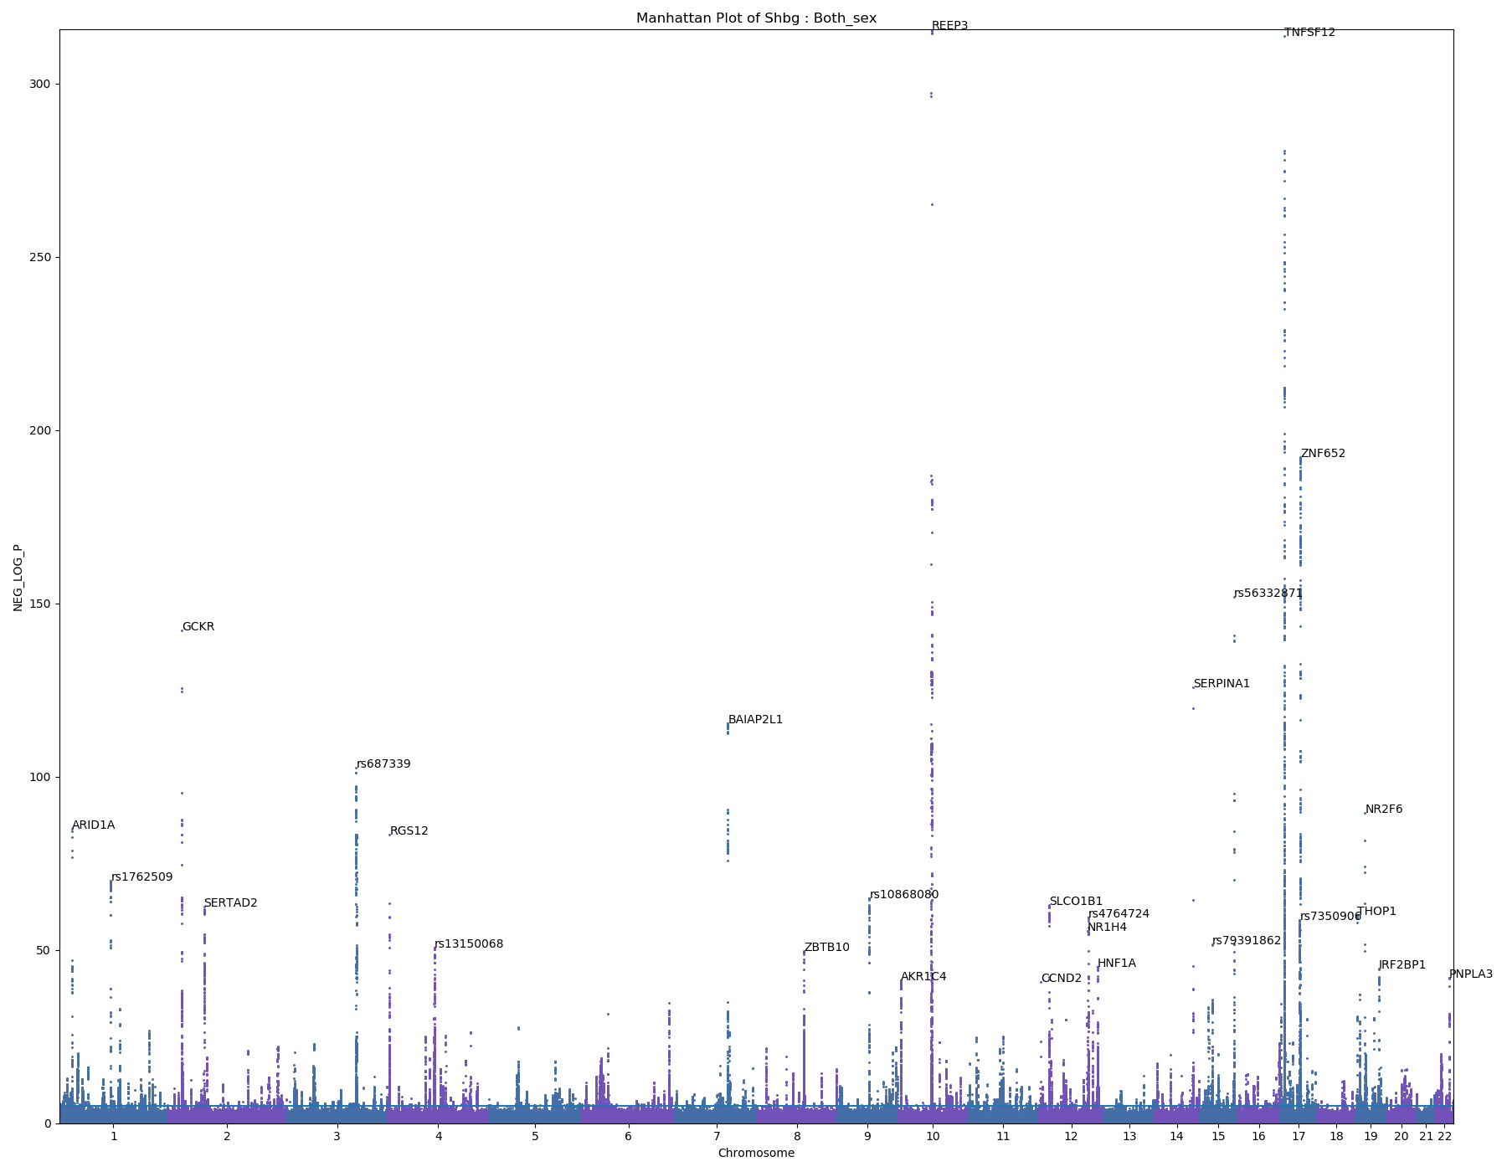
SHBG
Sex hormone binding protein
Produced in liver
Transports testosterone and estradiol in blood

Slide 11
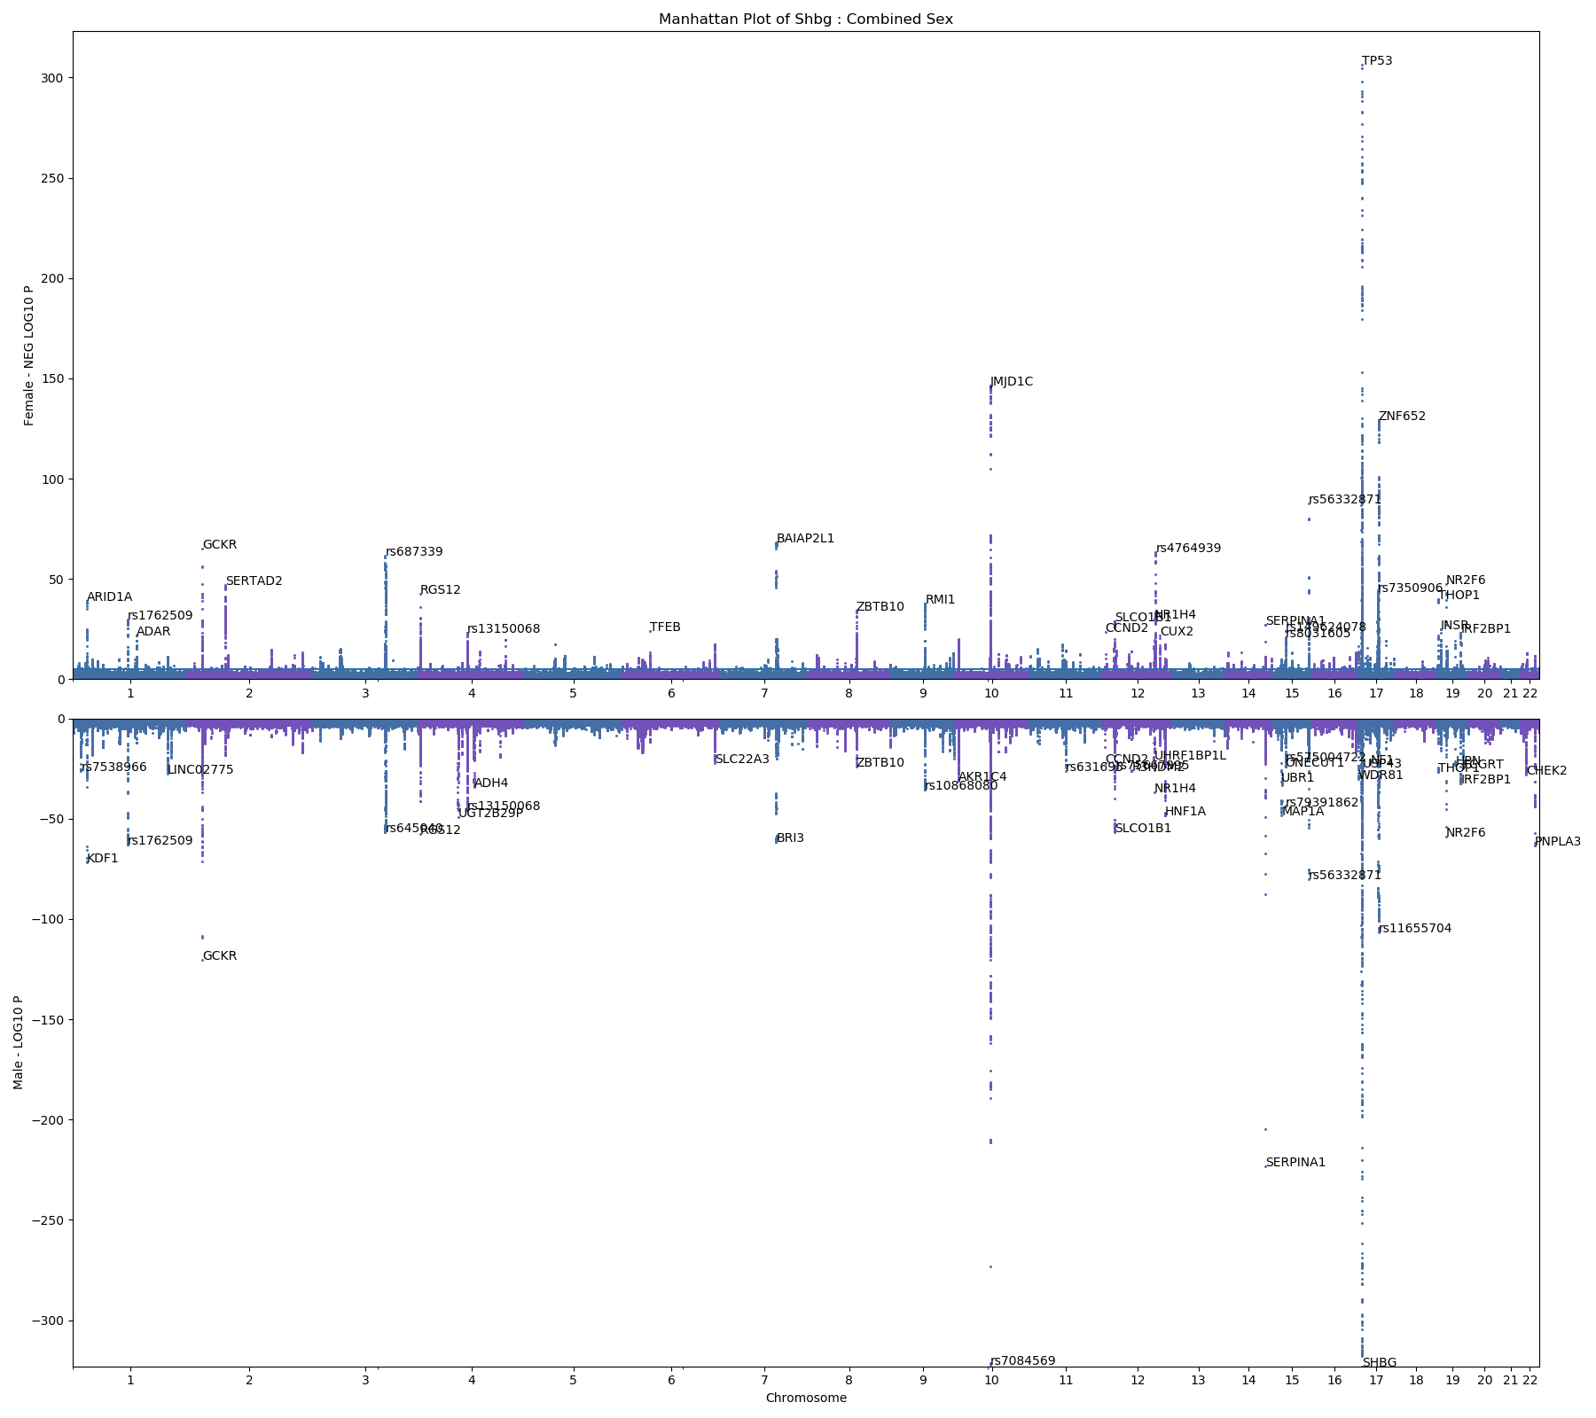
SHBG – M/F

Slide 12
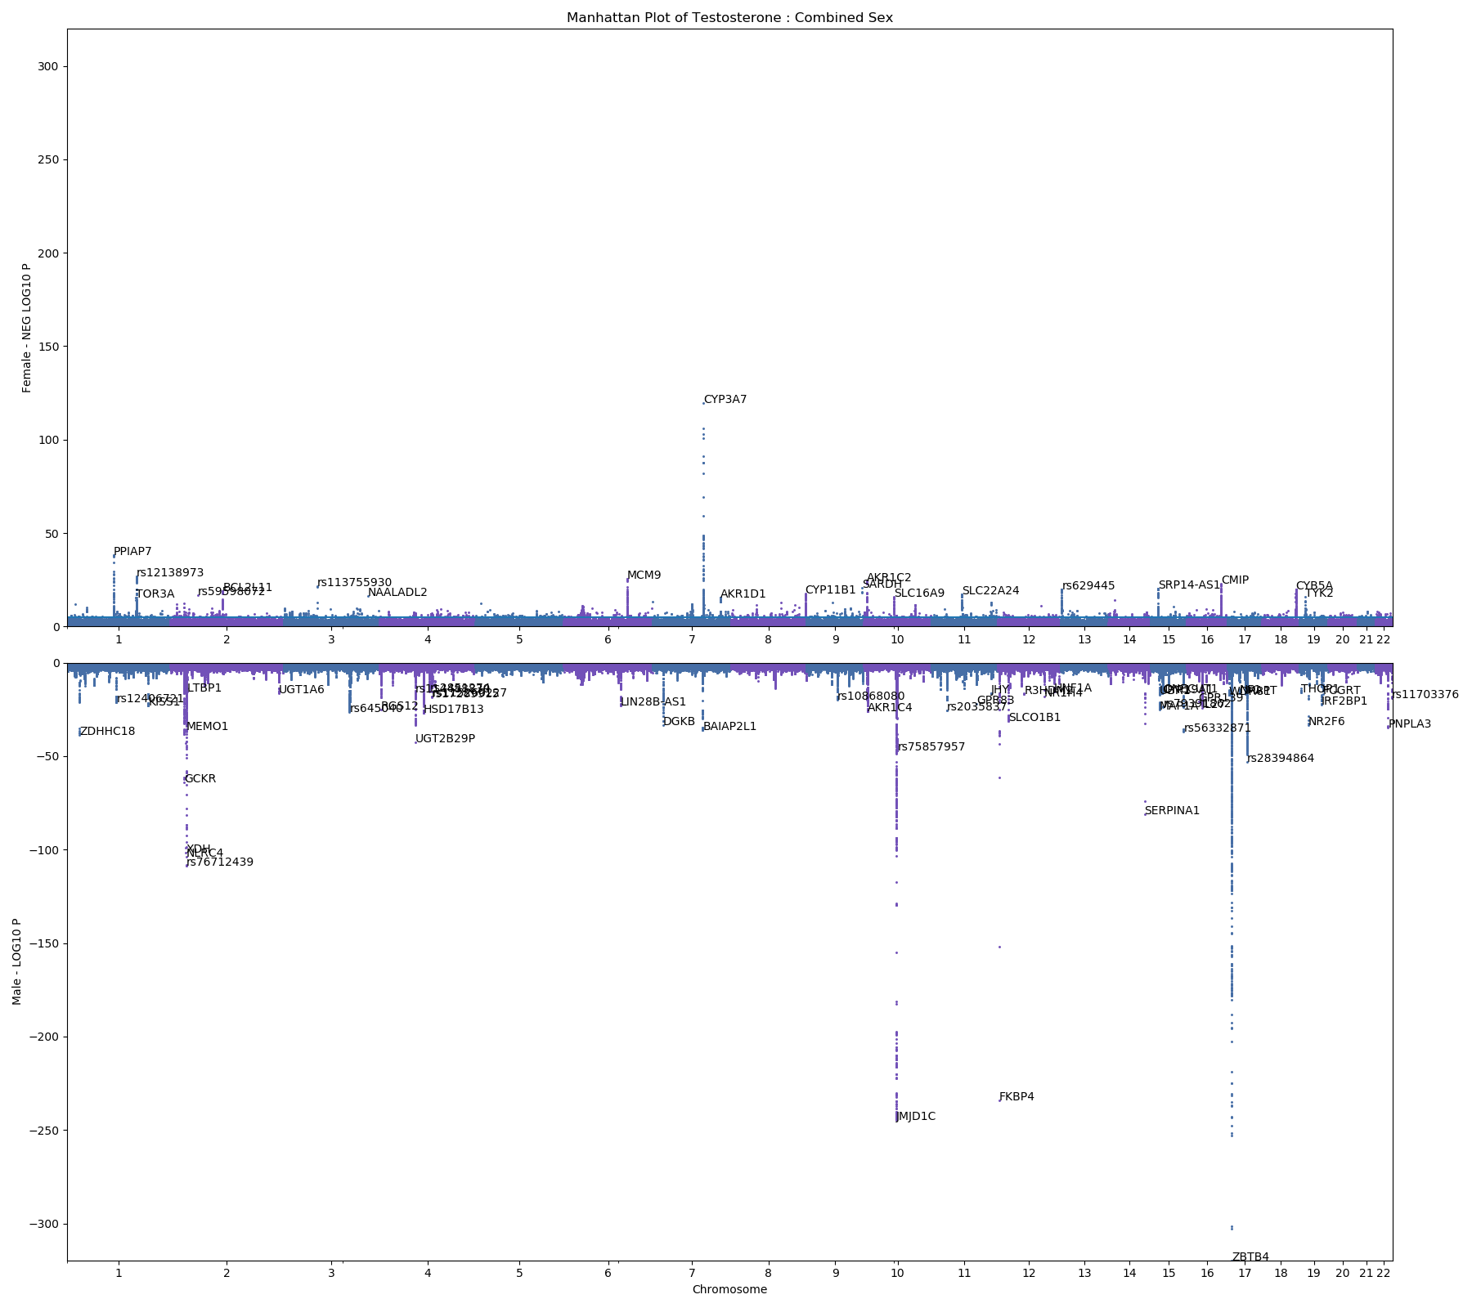
Testosterone

Slide 13
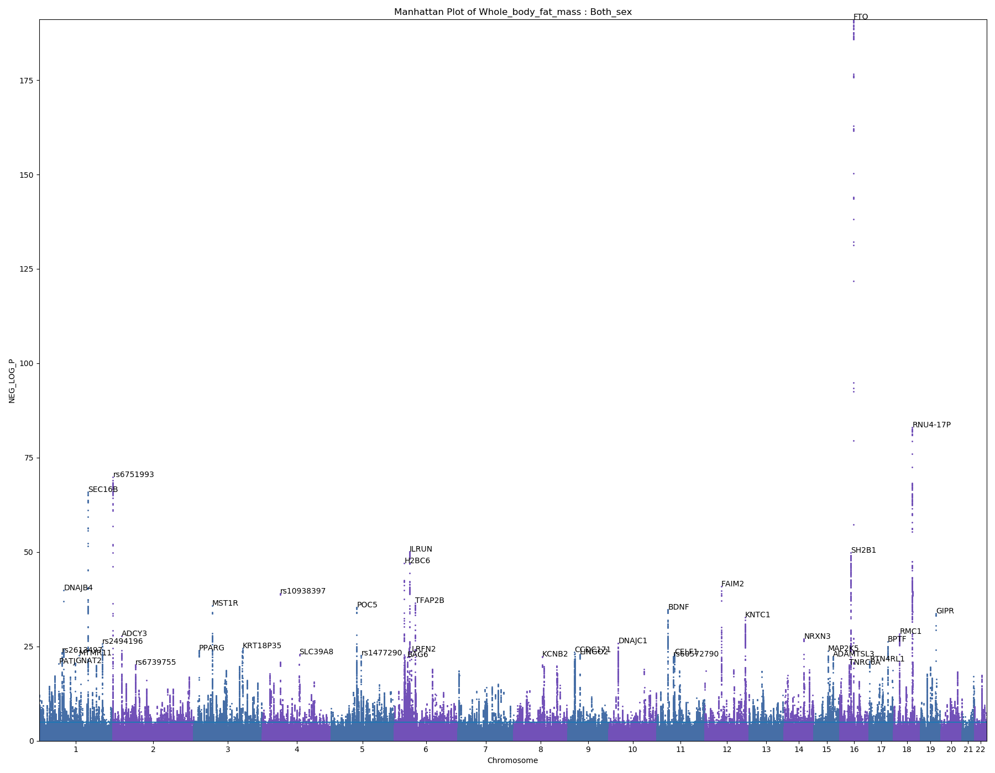
Whole Body Fat Mass

Slide 14
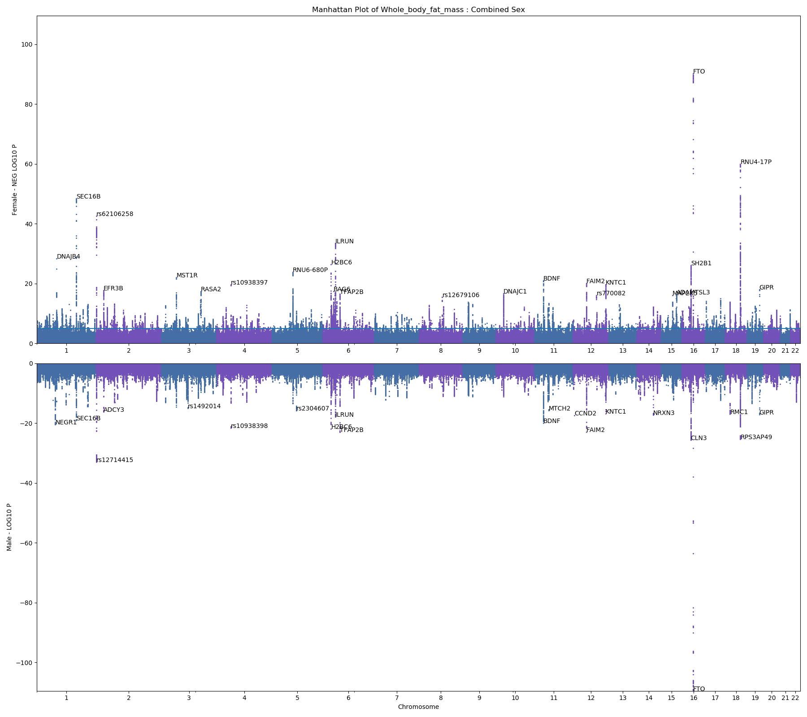
Whole Body Fat Mass – M/F

Slide 15
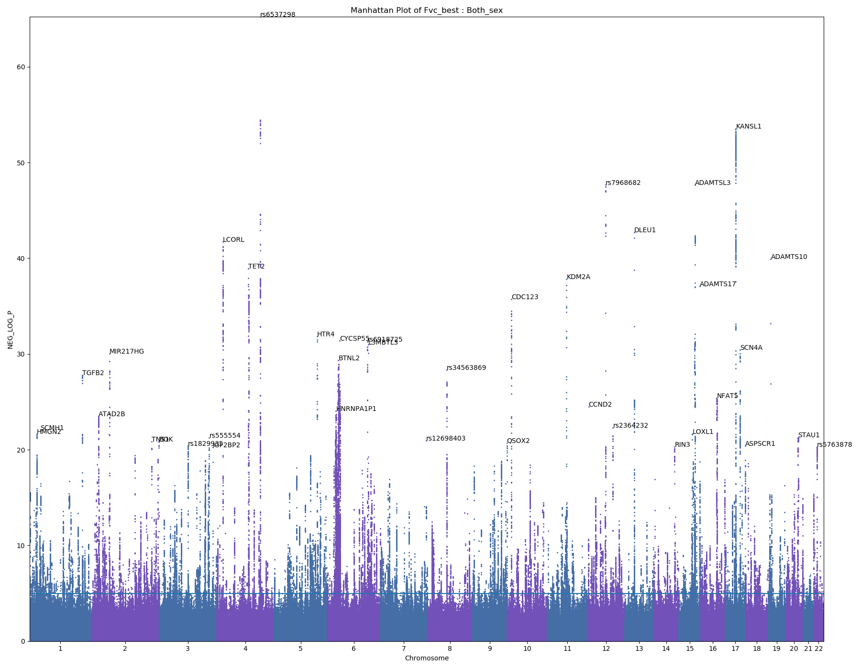
FVC (best measure)
Forced vital capacity
Max exhale
Highest measure from FVC which fit acceptability field

Slide 16
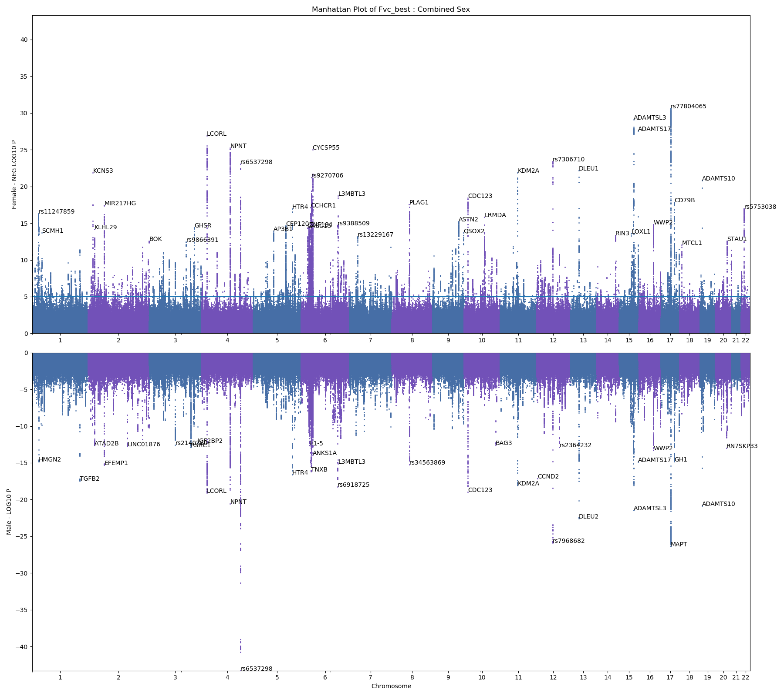
FVC (best measure) – M/F

Slide 17
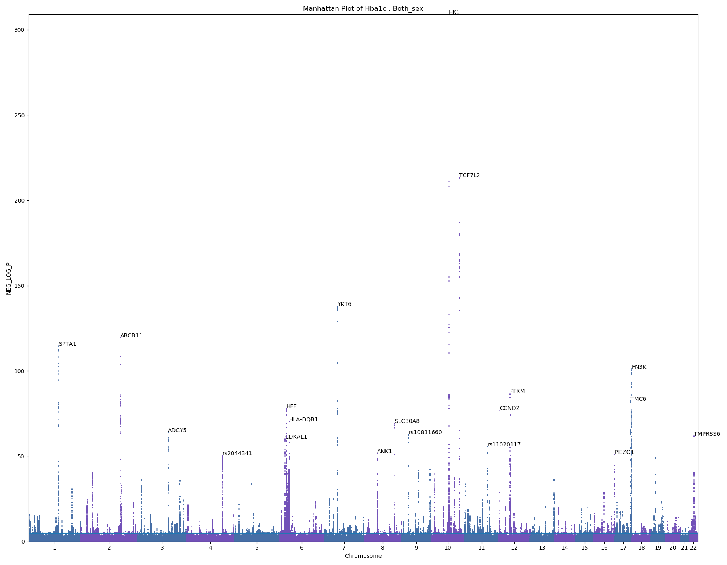
HbA1c
Amount of blood sugar attached to hemoglobin

Slide 18
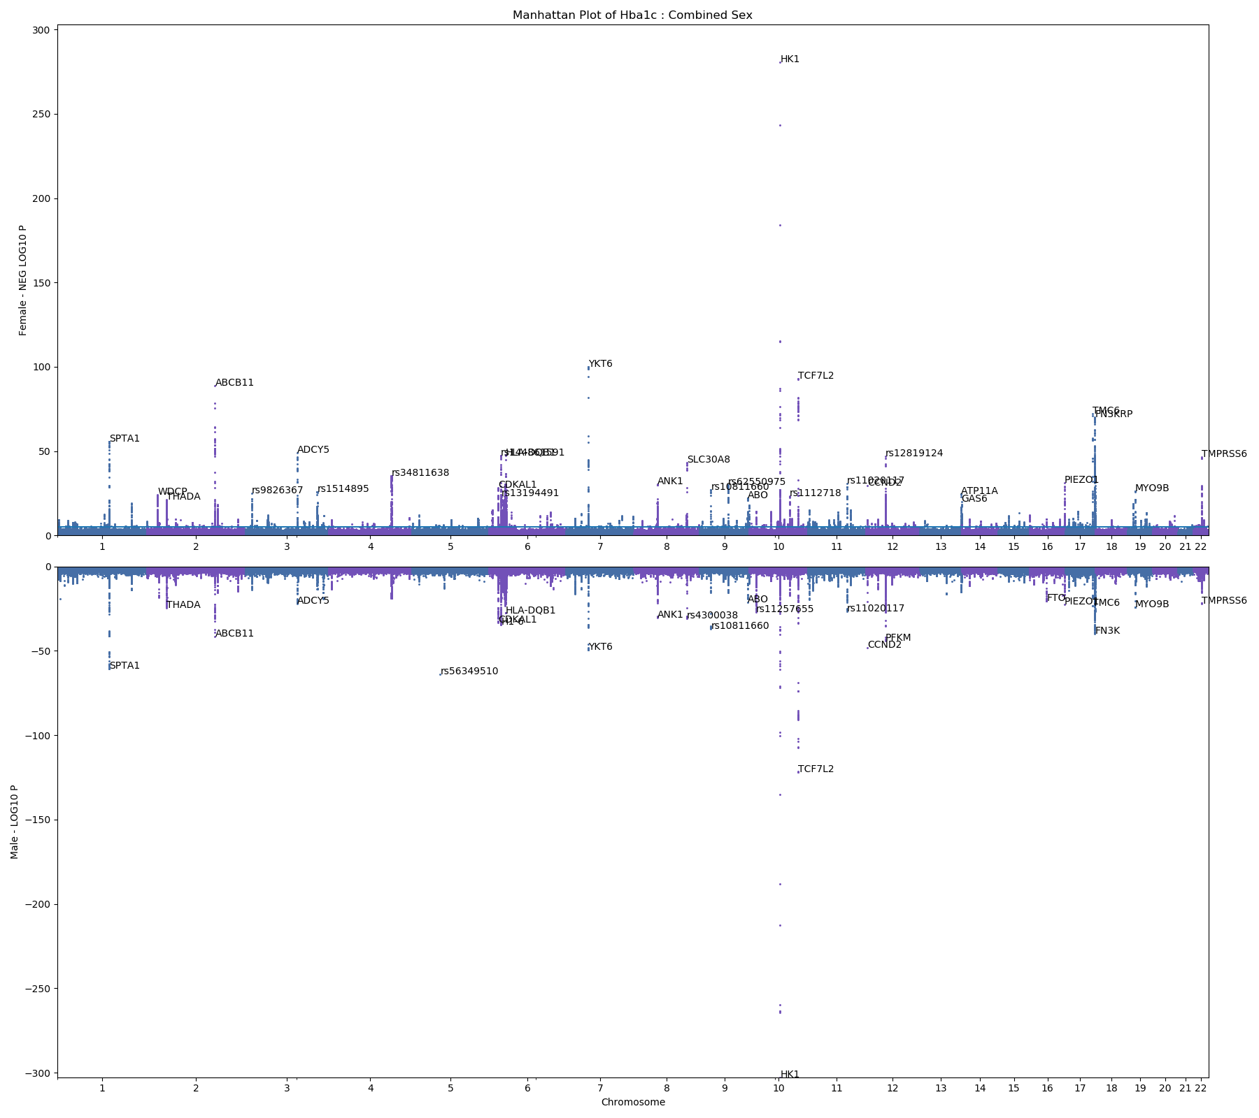
HbA1c – M/F

Slide 19
Heritability and Correlation
GWAS |  | My LDSC |  | Neale
Phenotype | Sex | Heritability | Intercept | Heritability | Intercept
Weight | Both | 0.2353 | 1.2583 | 0.266 | 1.116
 | Female | 0.2472 | 1.1058
 | Male | 0.2593 | 1.1217
Calcium | Both | 0.1031 | 1.1499 | 0.135 | 1.097
 | Female | 0.1074 | 1.10887
 | Male | 0.1203 | 1.0655
Total Protein | Both | 0.1281 | 1.2189 | 0.167 | 1.230
 | Female | 0.1258 | 1.124
 | Male | 0.1355 | 1.0958
Urea | Both | 0.093 | 1.1072 | 0.119 | 1.080
 | Female | 0.1029 | 1.0426
 | Male | 0.0913 | 1.0656
SHBG | Both | 0.142 | 1.1572 | 0.230 | 1.245
 | Female | 0.1603 | 1.1013
 | Male | 0.2087 | 1.0753
Whole Body Fat Mass | Both | 0.2163 | 1.2081 | 0.239 | 1.096
 | Female | 0.2351 | 1.0998
 | Male | 0.2353 | 1.0766
FVC (best measure) | Both | 0.1935 | 1.2027 | 0.238 | 1.147
 | Female | 0.2068 | 1.1201
 | Male | 0.2099 | 1.0877
HbA1c | Both | 0.1066 | 1.1622
 | Female | 0.112 | 1.0833
 | Male | 0.1159 | 1.0766
 | Correlation
Phenotype | Genetic
Weight | 0.9383
Calcium | 0.9668
Total Protein | 0.954
Urea | 0.9598
SHBG | 0.8354
Whole Body Fat Mass | 0.9191
FVC (best measure) | 0.9767
HbA1c | 0.9471

